Slide 1
Project 3 : Cyberbullying on social media
Sarah LÉOUFFRE Ingrid MONGORI YONDO Maher ZEGHIDA

Slide 2
Original Dataset
5000 tweets from Turkey
27 columns
Various information such as number of followers or following, Emojis, number of words etc.

Slide 3
Main challenges
Cleaning outliers – judging which are outliers and what to drop/delete
Transfer directly from Python to MySQL
Understanding all the available data

Slide 4



Process
Check for all missing values and decide how to manage them (dropped, replaced by mean, replaced by 0, calculated)
Drop columns with repeating data
Search for duplicates

Slide 5



Process
Manage outliers
Connect Python to MySQL and export data
Insights

Slide 6
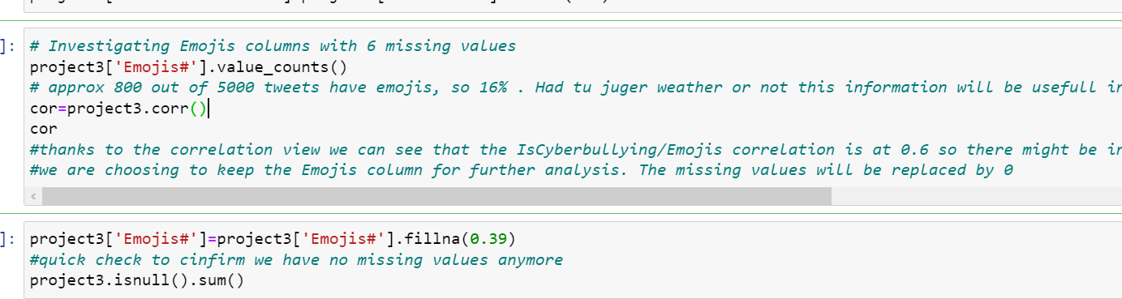
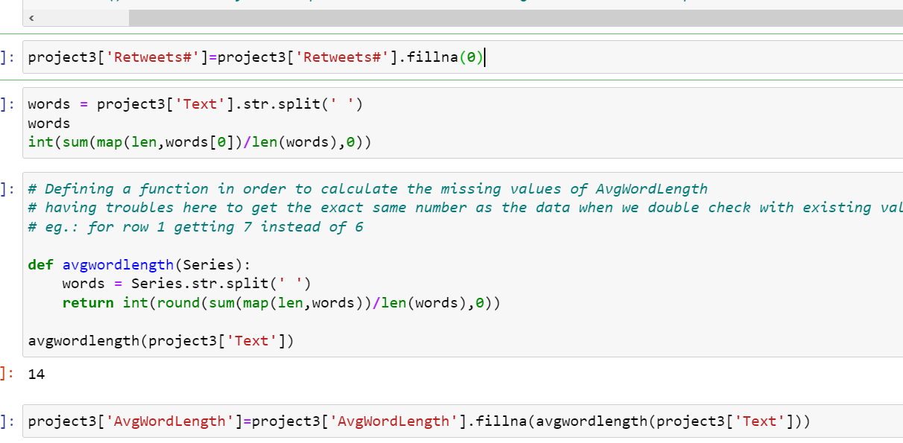
Python Demo
Module used
Manage missing data
Functions used for data prep

Slide 7
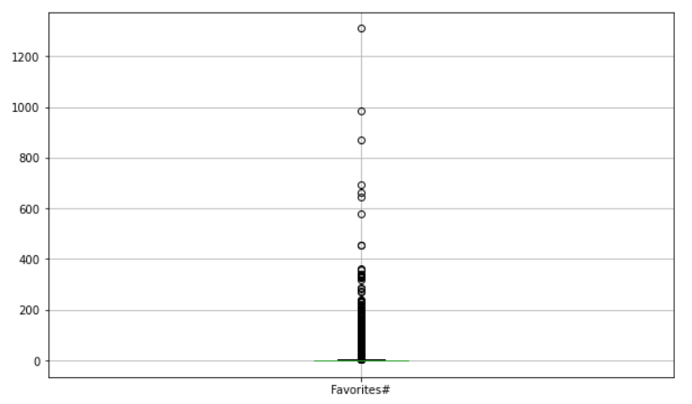
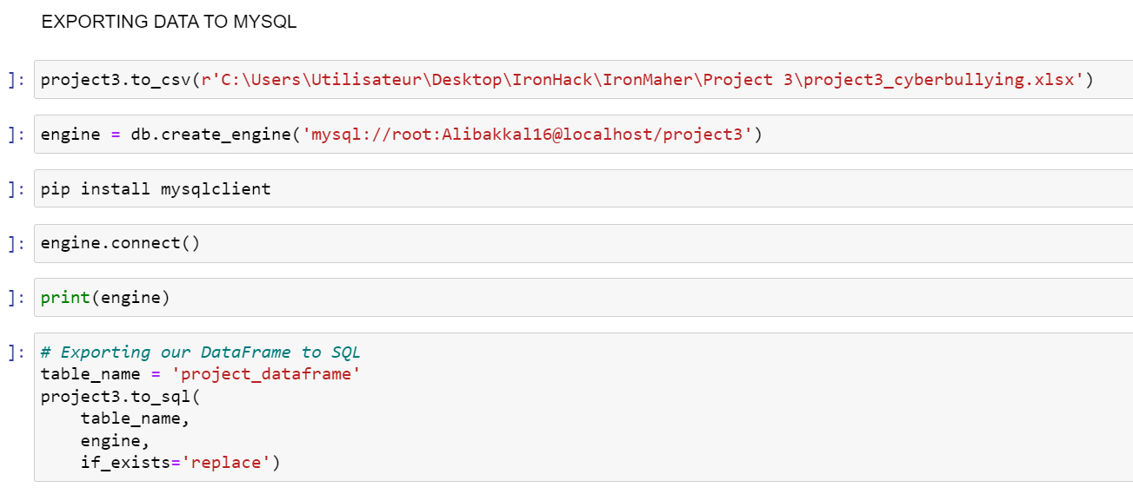
Python Demo
Outliers identification and management
Export data to sql

Slide 8
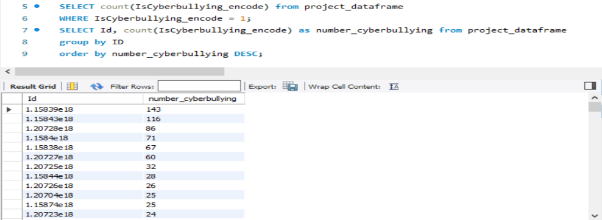
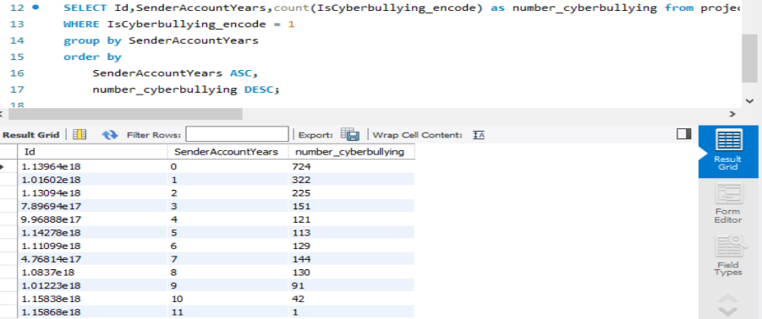
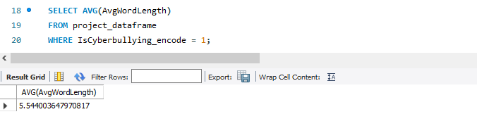
SQL Demo
Meaning people tend to create new, probably anonymous, accounts to publish these tweets
Most accounts that published tweets considered as "Cyberbullying" are less than a year old (724/2193 or 33%)
Functions used for data prep

Slide 9
Final Dataset
5000 tweets
3513 tweets (rows)
16 columns
Needed information such as number of followers or following, number of words, average length word, etc.
27 columns
Various information

Slide 10
Questions ?

